Slide 1
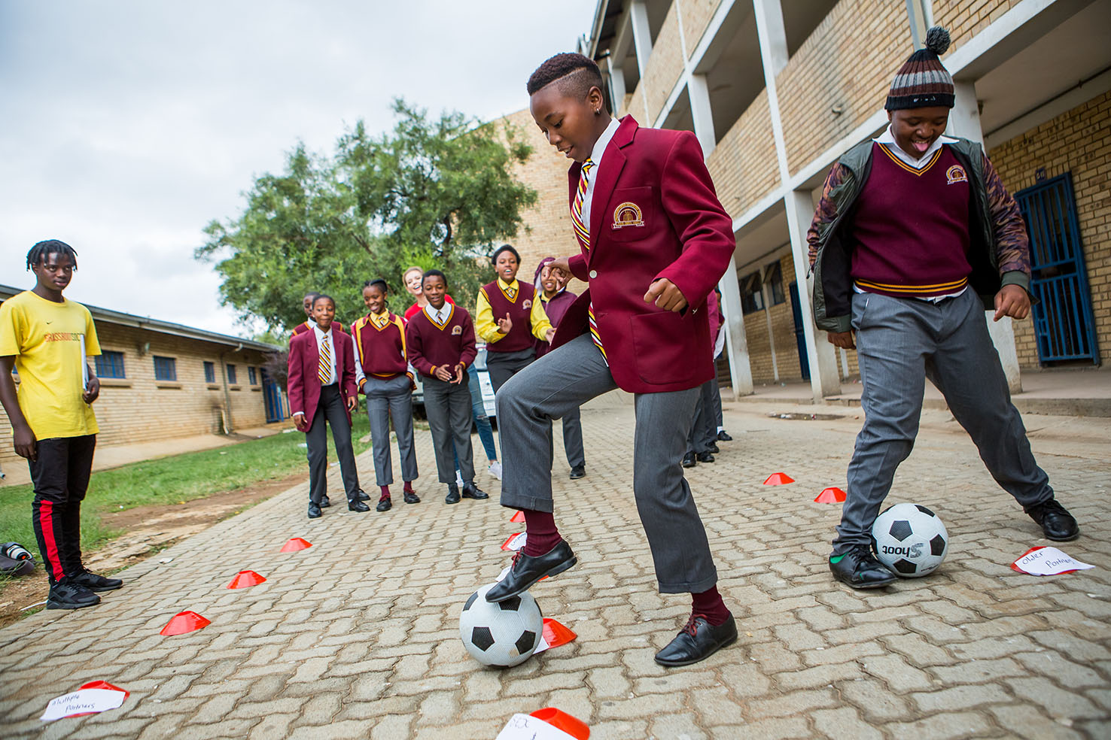



CHANGING THE GAME IN
ADOLESCENT-CENTERED DESIGN:
ASSETS, ACCESS, ADHERENCE
#changingthegame #AIDS2108
Please tag @grassrootsoccer

Slide 2
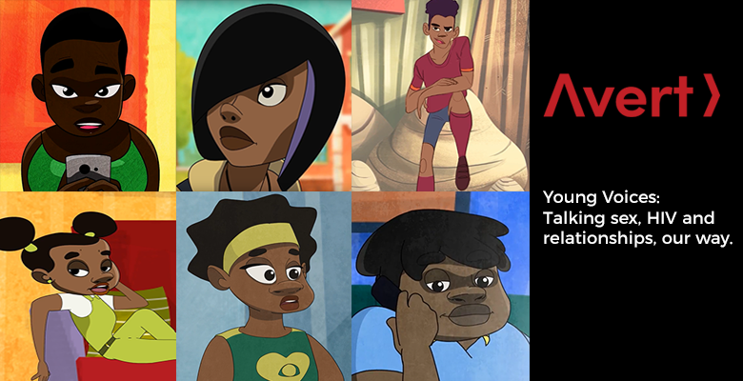


Simon Moore, Head of Digital Content and Marketing
Caitlin Mahon, Content Specialist

Slide 3


Avert: working in global HIV information and education for the past 30 years to empower people through knowledge.

Slide 4
About Young Voices Africa
A co-creation project to produce sexual and reproductive health information materials – created by, and for, young people between 15 and 24 years old in Southern Africa.

Slide 5

Improves HIV knowledge
Encourages behaviour change
Reflects young people’s experiences
Creates content that resonates
Tailored to young people’s needs
Promotes meaningful engagement
Co-Creation
Creates content that fills a genuine knowledge gap
Creates content that is authentic
Promotes messaging that is engaging and powerful

Slide 6
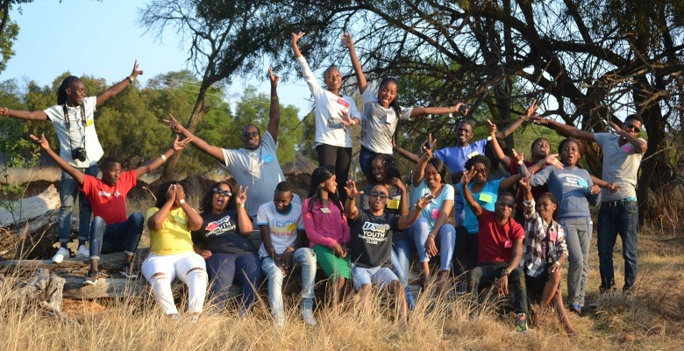
Co-creating Young Voices – how it happened
Regional Workshop
Identify gaps
Identify and validate themes
Co-create initial ideas for content and messaging
Establish most effective formats, platforms and channels, visual preferences.

Slide 7
Co-creating Young Voices – how it happened
Country WhatsApp Groups
5 country-specific WhatsApp groups to input to and validate:
  initial concepts and messaging for each theme
  look and feel
  scripts
  supporting materials
Johannesburg-based youth design agency.

Slide 8
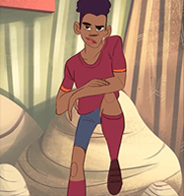

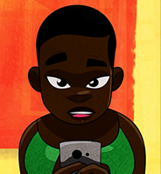
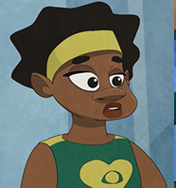

Six stories. Six dilemmas.
Young Voices Africa - overview
SPIJO
Sex without a condom
CHIPO
Saying no to sex
BABALWA
Options for contraception
MWAISE
Dating older men
LINEO
Talking about HIV
MARTHA
Unhealthy relationships

Slide 9
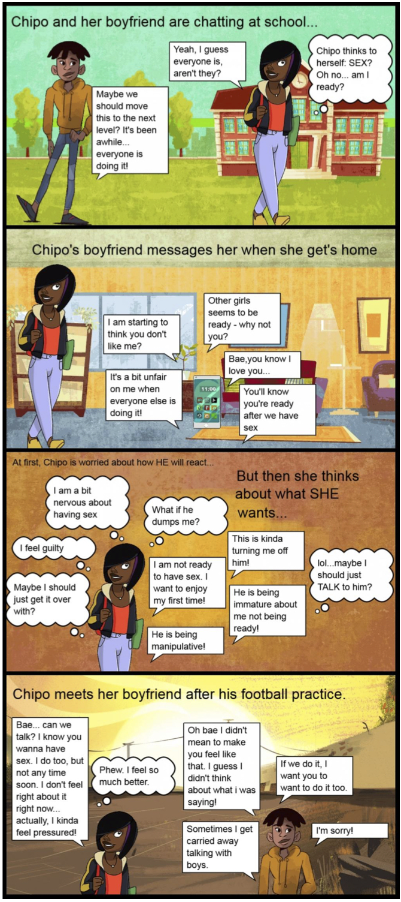
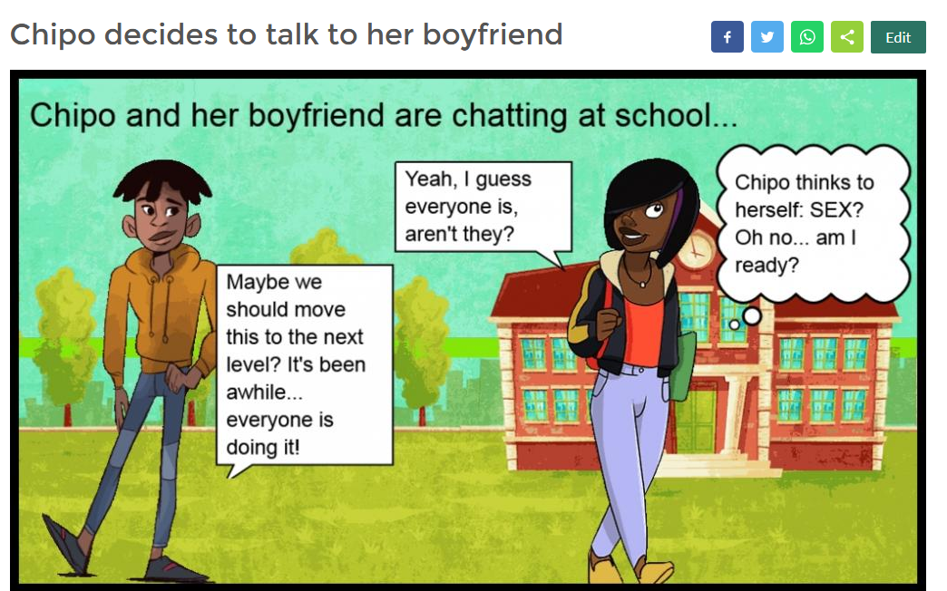
Think. Discuss. Create.
Participants finish the story using the online comic creator.

Slide 10


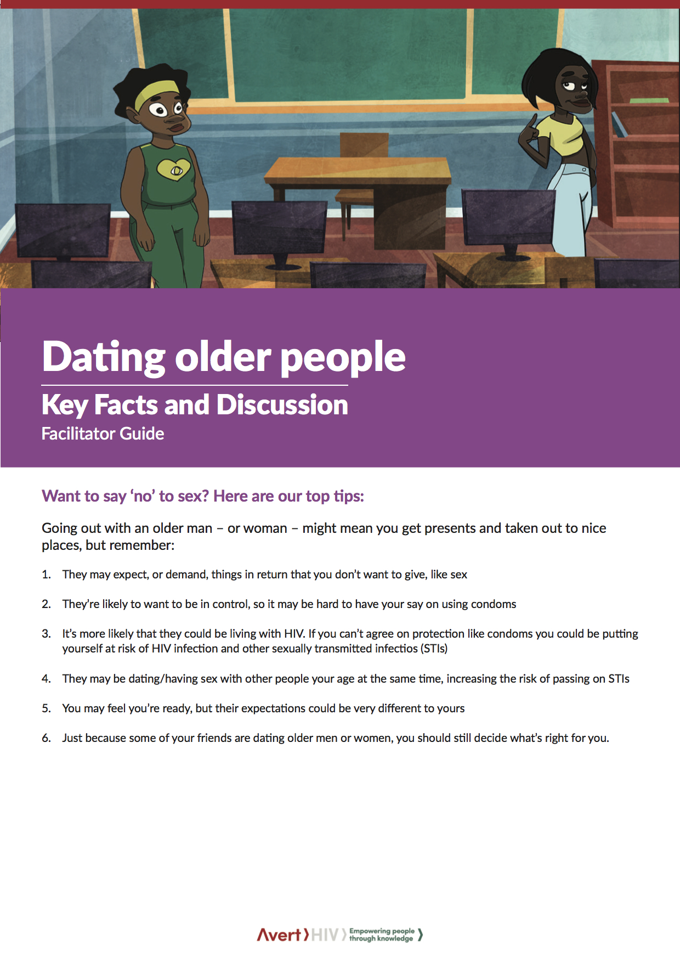


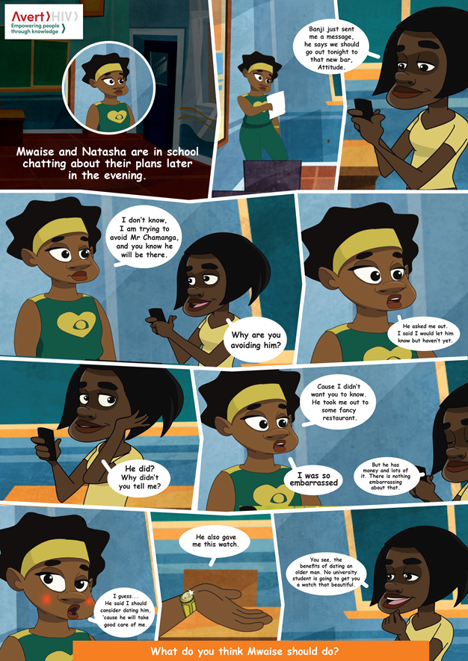

Young Voices Africa -
Think. Discuss. Create.

Slide 11
So what’s next?
Find all the resources at: www.Avert.org/young-voices
Join our co-creation workshop – 3pm on Thursday 26th in the Global Village Café.
Come visit us anytime at our Global Village Booth #654!

Slide 12

Thank you!
Simon Moore
Head of Digital Content and Marketing
simon.moore@avert.org
Caitlin Mahon
Content Specialist
caitlin.mahon@avert.org
There are no conflicts of interest to declare.

Slide 13

Meet Spijo!

Slide 14
CHANGING THE GAME IN
ADOLESCENT-CENTERED DESIGN:
ASSETS, ACCESS, ADHERENCE
#changingthegame #AIDS2108
Please tag @grassrootsoccer

